Slide 1
Employees and Employment Trends
Module Code and Version #
MANAGING MEETING 1

Slide 2
CLASS RULES
PLEASE BE PUNCTUAL
For online classes, you must ‘on’ the audio & camera whenever you speak
When you are not speaking, please mute your audio and off the camera.
Please use the chat option to communicate with lecturer and classmates whenever required
Participate actively during class.
Ensure you have scanned your attendance.
Always check your Microsoft Teams for any updates.

Slide 3
Topic & Structure of The Lesson
Introduction of Meeting
Planning and preparation:
-Objective of Meeting
-Agenda
Roles of Chairperson, Secretary, Treasurer and participants
Minutes of Meeting

Slide 4
Learning Outcomes
At the end of this module, YOU should be able to:
1. Make the necessary preparations for a meeting to achieve the desired outcomes
2. Conduct an effective meeting

Slide 5
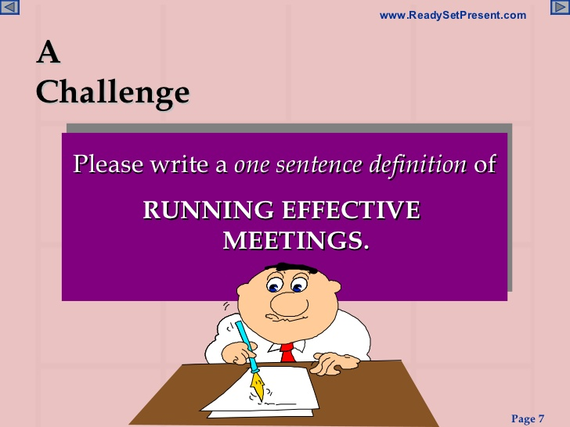

Slide 6
Introduction
Meeting
◆ A meeting is a gathering of two or more people that has been convened for the purpose of achieving a common goal through verbal interaction, such as sharing information or reaching agreement.

Slide 7
Purpose of Meeting
Sharing Information
Making Decisions
Creating Solutions
Building Relationships
Sharing Inspiration
Negotiating
Educating Others

Slide 8
Planning a Meeting
»Pre
»In
»After
As you plan a meeting, determine the focus of the meeting
• Decide who should attend
• Choose the best time and place to hold it
• Prepare an agenda for the meeting
• And determine who should take the minutes.

Slide 9
Agenda of Meeting
An agenda sets out the list of items to be discussed at a meeting.
It should include:
The purpose of the meeting.
The order in which items are to be discussed, so that the meeting achieves its purpose.
This will later shape the minutes of the meeting.

Slide 10
Sample of Meeting Agenda

Slide 11
Minutes of Meeting
Meeting minutes can be defined as the written record of everything that's happened during a meeting.
They're used to inform people who didn't attend the meeting about what happened.
To keep track of what was decided during the meeting so that you can revisit it.
Use it to inform future decisions.

Slide 12
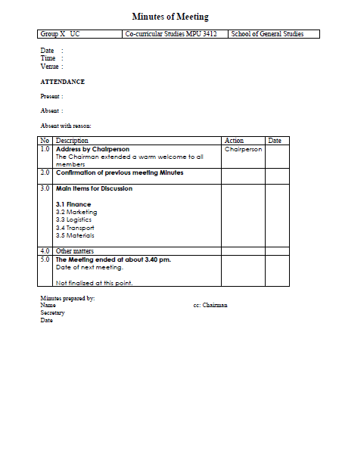
Sample of Minutes of Meeting

Slide 13
ROLES OF CHAIRPERSON
Prepare for the meeting: focus on purpose and people
Manage the meeting
Establish ground rules
Agree desired outcomes
Agree decision making method
Set and keep to the agenda
Summarize and signpost
Ensure participation
Seek “devil’s advocate”
Adjudicate in disputes
Deal with problem people
Draw to conclusion

Slide 14
Roles of Secretary
makes the arrangements for the meetings, including AGMs, and keeps formal records of the group’s process and decisions: the minutes of the meeting & keeping records of correspondence.
Preparation before, during and after the meeting

Slide 15
Roles of Participant
Know the purpose and prepare
Confirm attendance and be on time
Participate
Keep an open mind
Share your ideas
Behave yourself!

Slide 16
Summary of Main Teaching Points
Purpose of Meeting is sharing information, making decisions, creating solutions, negotiating, educating others.
Different between Meeting agenda and minutes of meeting

Slide 17

Q & A session

Slide 18
Next week topic
Attitudes

Slide 19
ATTENDIX
&
THANK YOU

